Slide 1



P-HRL: An Adaptive and Flexible Prediction-based Hierarchical Reinforcement Learning for Robot Soccer
Zongyuan Zhang, Tianyang Duan, Zekai Sun, Xiuxian Guan, Shengliang Deng, Yong Cui, Hongbin Liang, Heming Cui
The University of Hong Kong
Tsinghua University
Southwest Jiaotong University

Slide 2
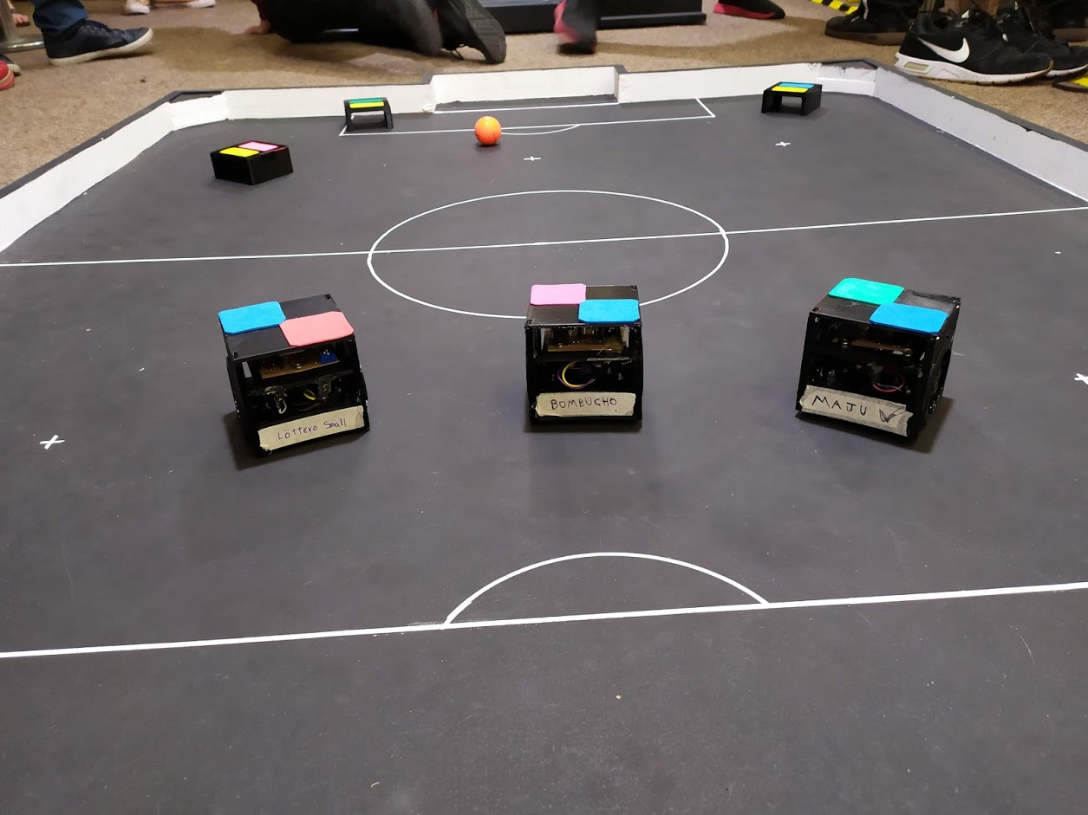
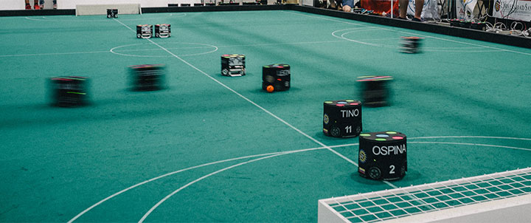
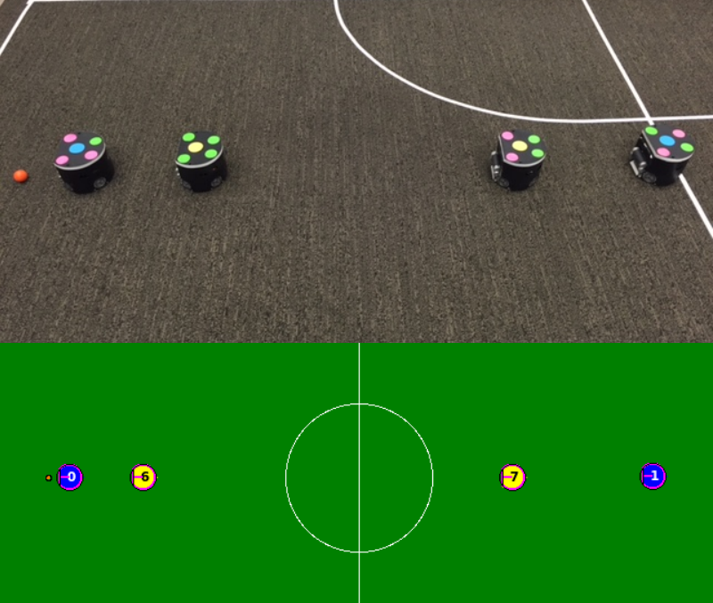
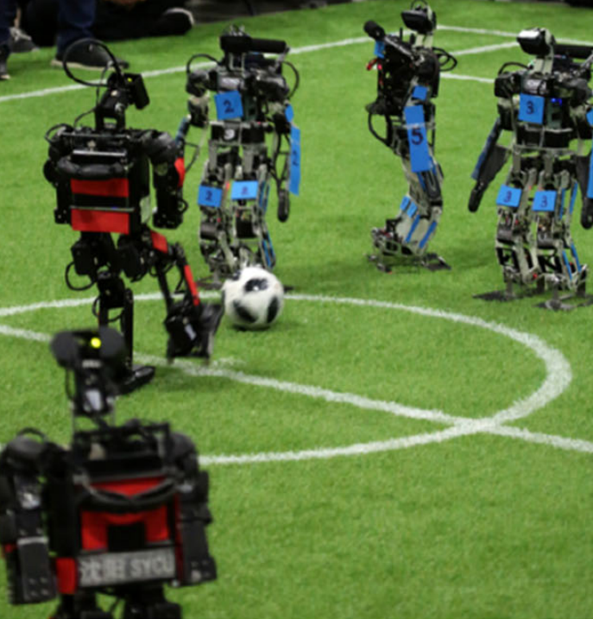
Motivation
Robot soccer is a robot sports game in which both parties control a team of robots and cannot be manually controlled during the game.
A robot cooperation scenario: need effective team strategies and joint decision-making processes
Several leagues have been successfully organized in recent years.
e.g., RoboCup, IEEE Very Small Size Soccer (IEEE VSSS).
Promoted research in academic scenarios
e.g., path planning, humanoid robot research

Slide 3
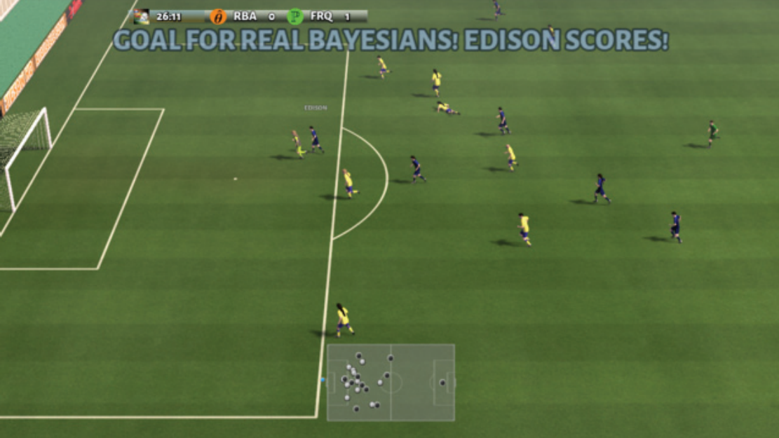
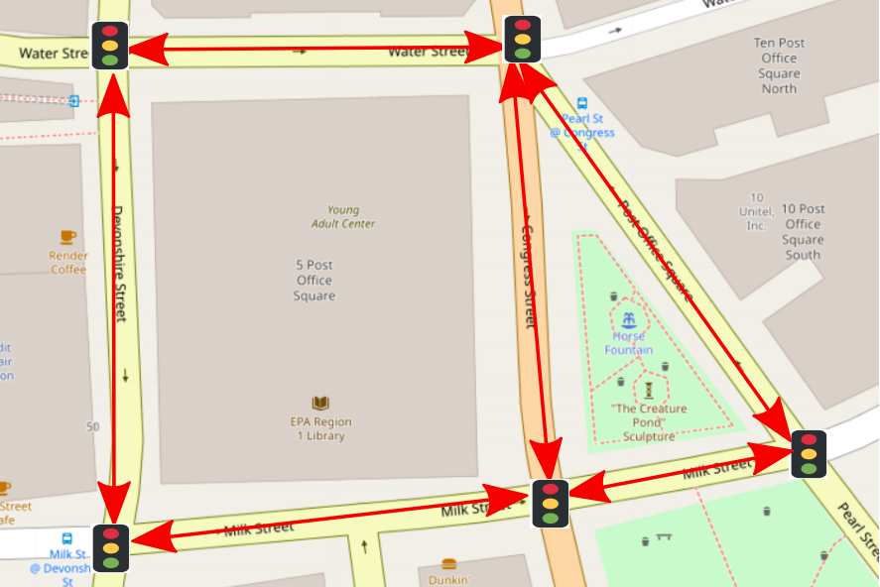
Existing MARL Method
Multi-agent reinforcement learning (MARL) has achieved outstanding success on cooperative scenarios.
e.g., video games(Google research football), cooperative traffic light control.
Thus, the MARL approach has great potential in robot soccer.
MARL controls the actions of multiple agents based on rewards to maximize the expected rewards by continuously interacting with the environment.
Actor-critic structure
e.g., MADDPG, MATD3.
Env
agent
MARL
②action
A "high-efficient" multi-agent reinforcement learning environment：
diverse reward feedback and simple state-action space
state
①
actor
③
④evaluate
reward
③
critic
×N

Slide 4
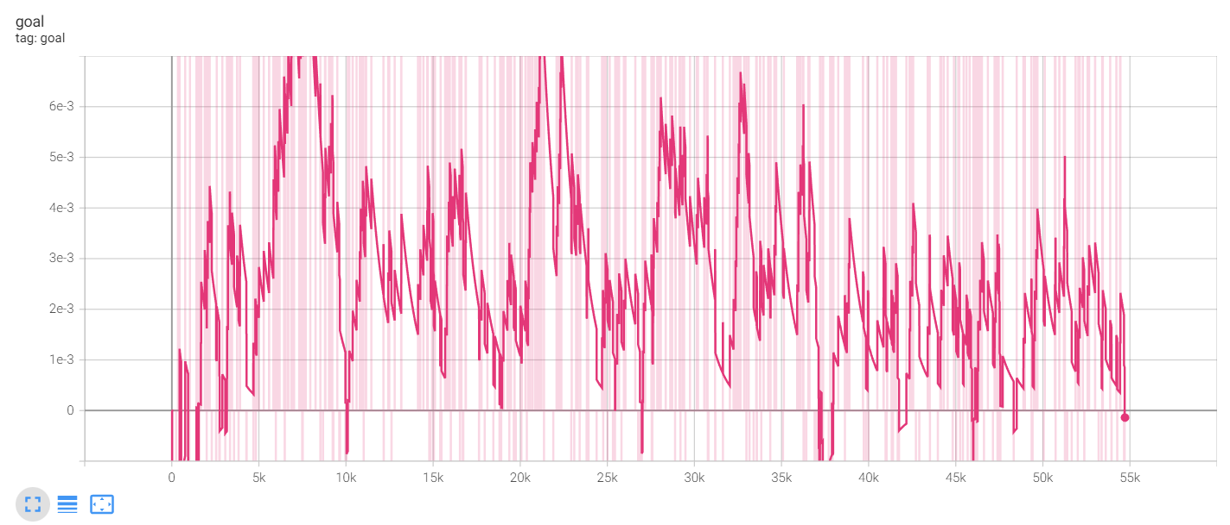

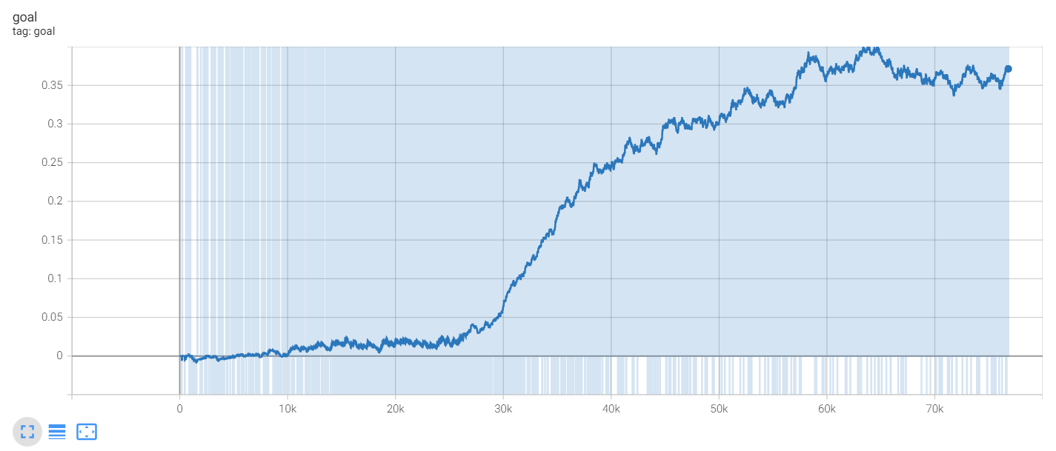



Problems of Existing MARL in Robot Soccer
robot1
robot2
robot3
A "high-efficient" multi-agent reinforcement learning environment：
① Continuous and timely reward feedback
② Different reward feedback for each agent
③ Low-dimensional and limited state-action space
②Pass
①Pass
?
③score a goal
?
reward
However, in robot soccer：
① Sparse reward
Long-term process; occurs infrequently
② Global reward
Cannot assign to each robot
Number of goals scored by MADDPG during training in 3 vs 3 robot soccer
 | Video game（Google research football） | Robot soccer (IEEE VSSS)
action space | Only 20 actions (e.g., left, short Pass.) | Left wheel speed: range [-1,1] Right wheel speed: range [-1,1]
Number of goals scored by DDPG during training in 1 vs 3 robot soccer
③ High-dimensional and continuous state-action spaces
Difficult to fully explore
It difficult for MARL to learn to collaborate in robot soccer.

Slide 5
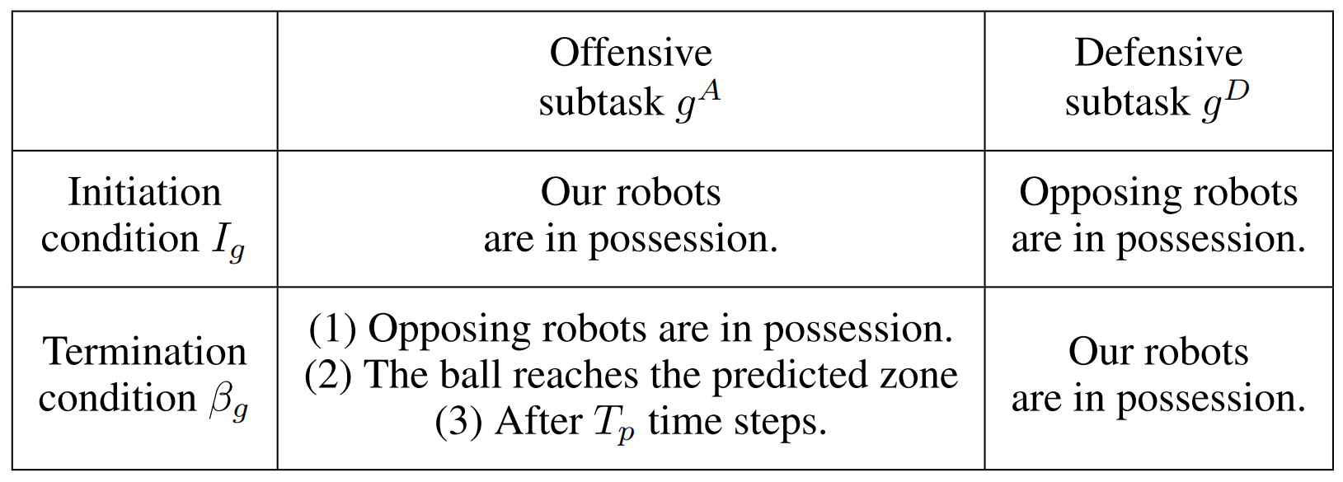
Key Idea: Subtask Decomposition by Coach
The coach assigns different subtasks to each robot.
Give each robot different and continuous reward feedback
Two types of subtasks: offensive subtask and defensive subtask
Guarantee possession of the ball
Select based on ball possession
A robot soccer game
offensive subtask
offensive subtask
defensive subtask
...
offensive subtask
Time
MARL gives a low-level joint action.
The coach gives a subtask.
offensive subtask
defensive subtask
Legend
home team player
ball
high-level policy
away team player
Soccer Position
Prediction
low-level joint action

Slide 6

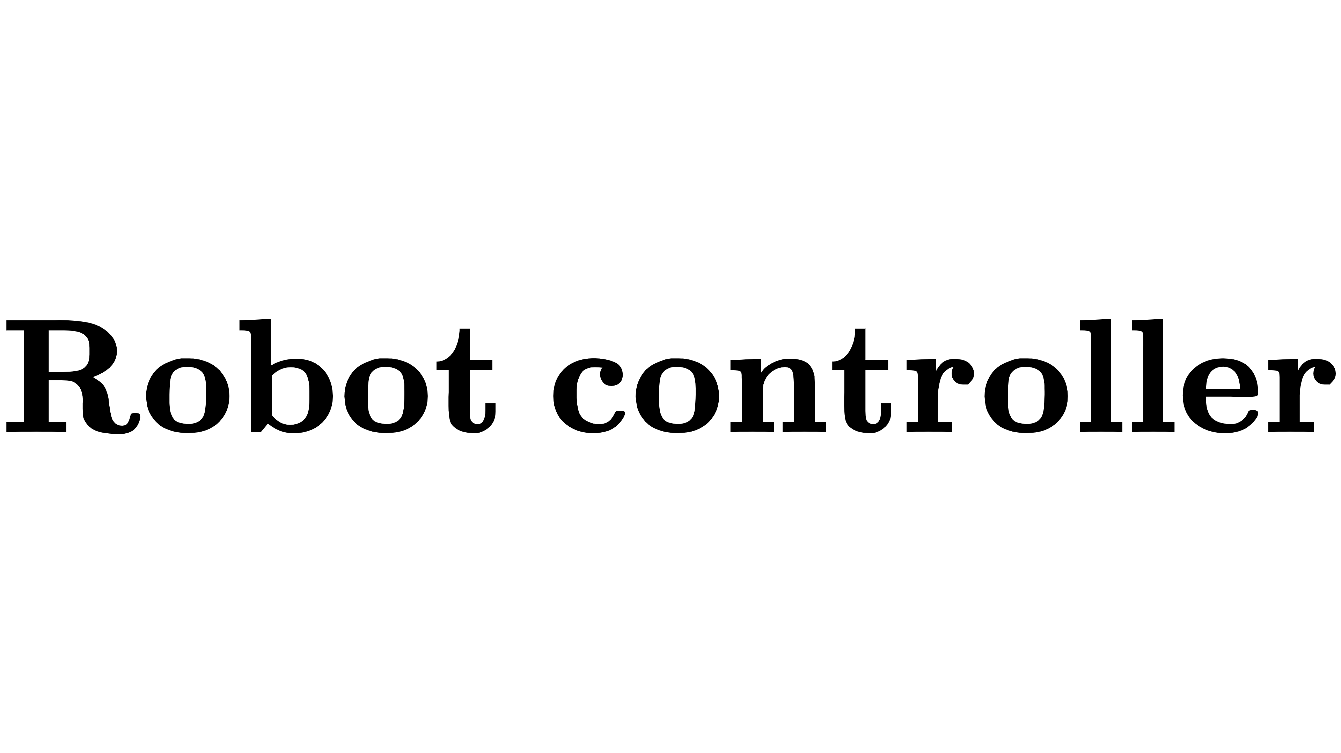

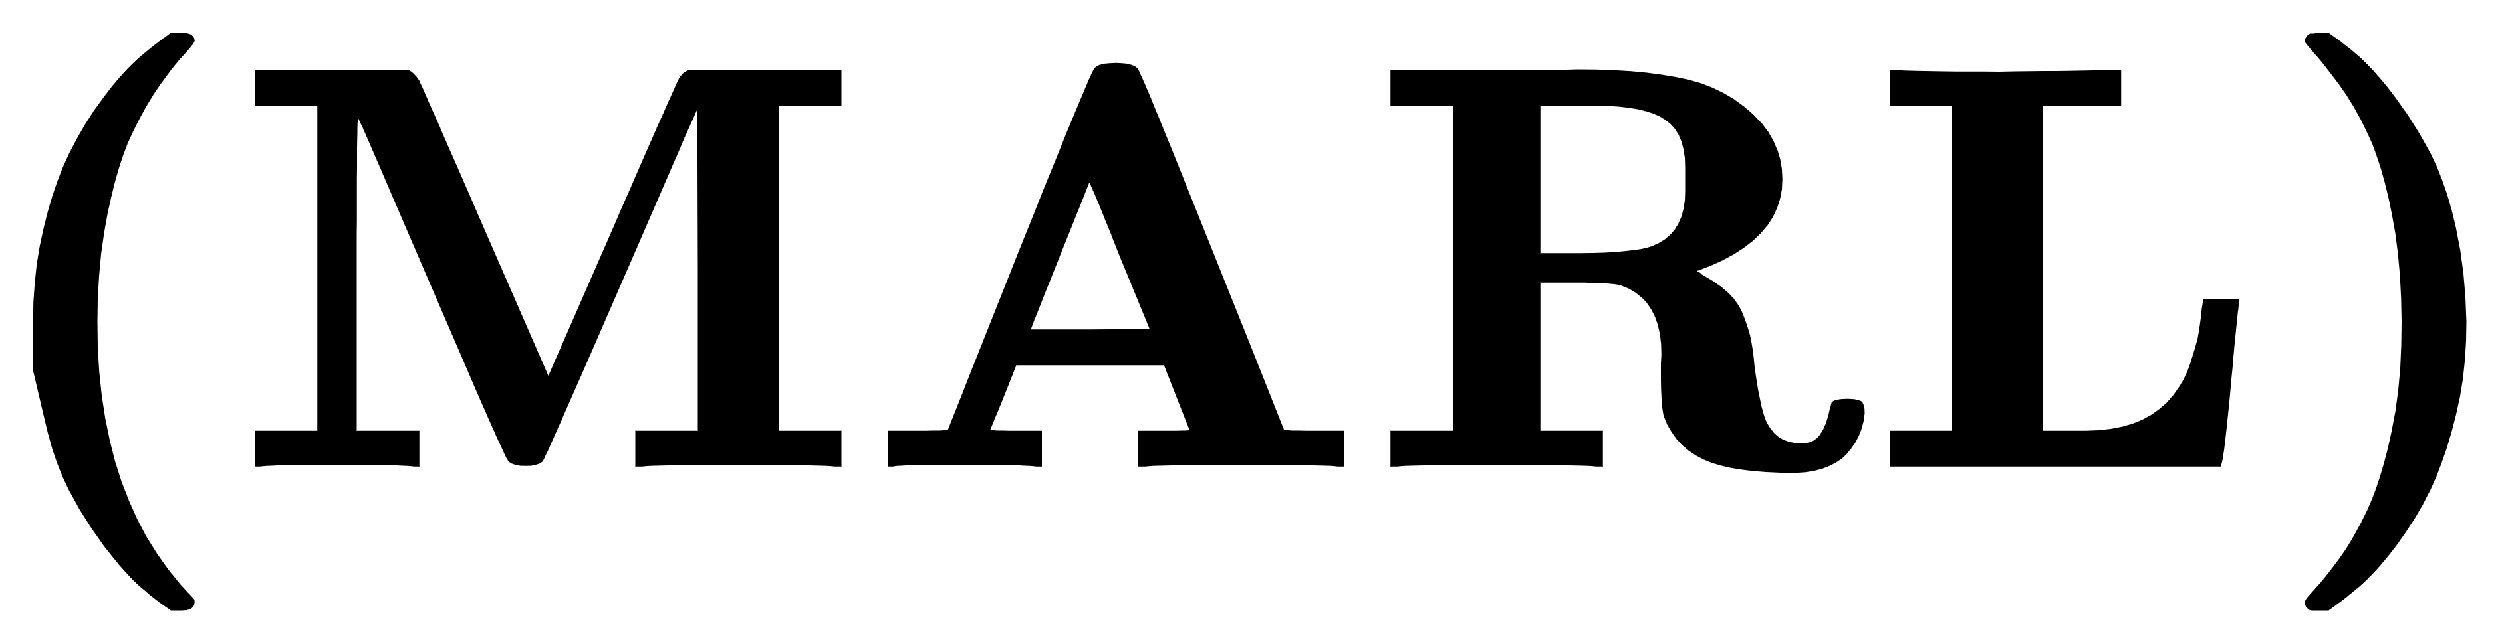

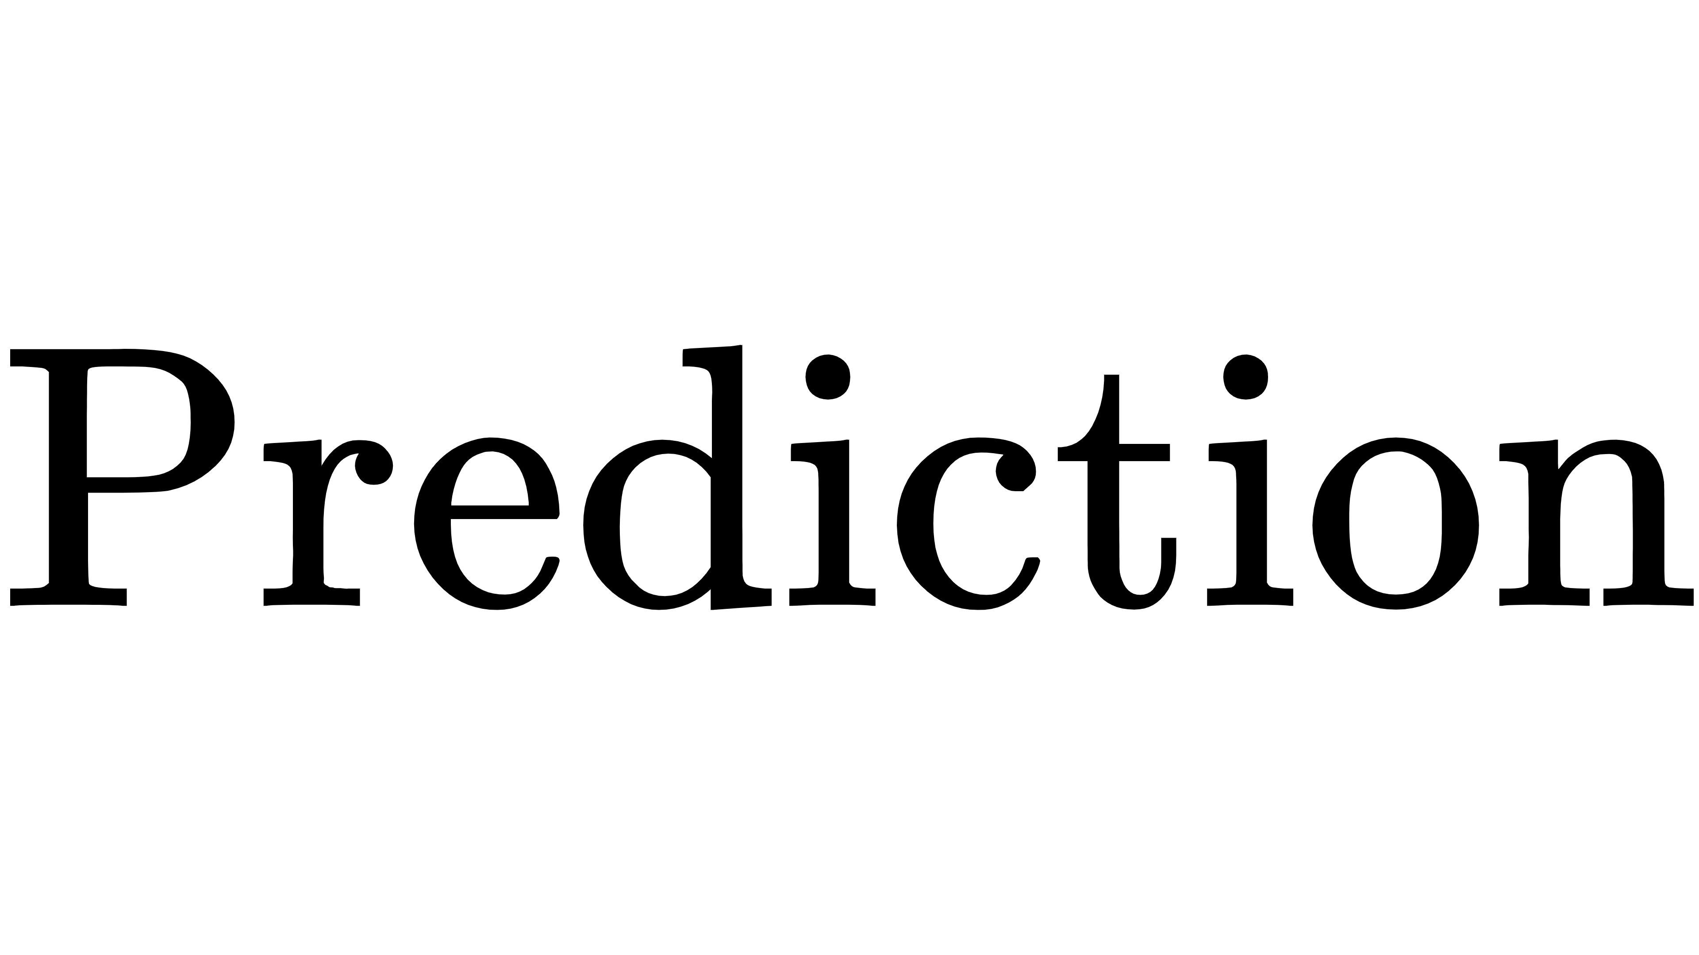
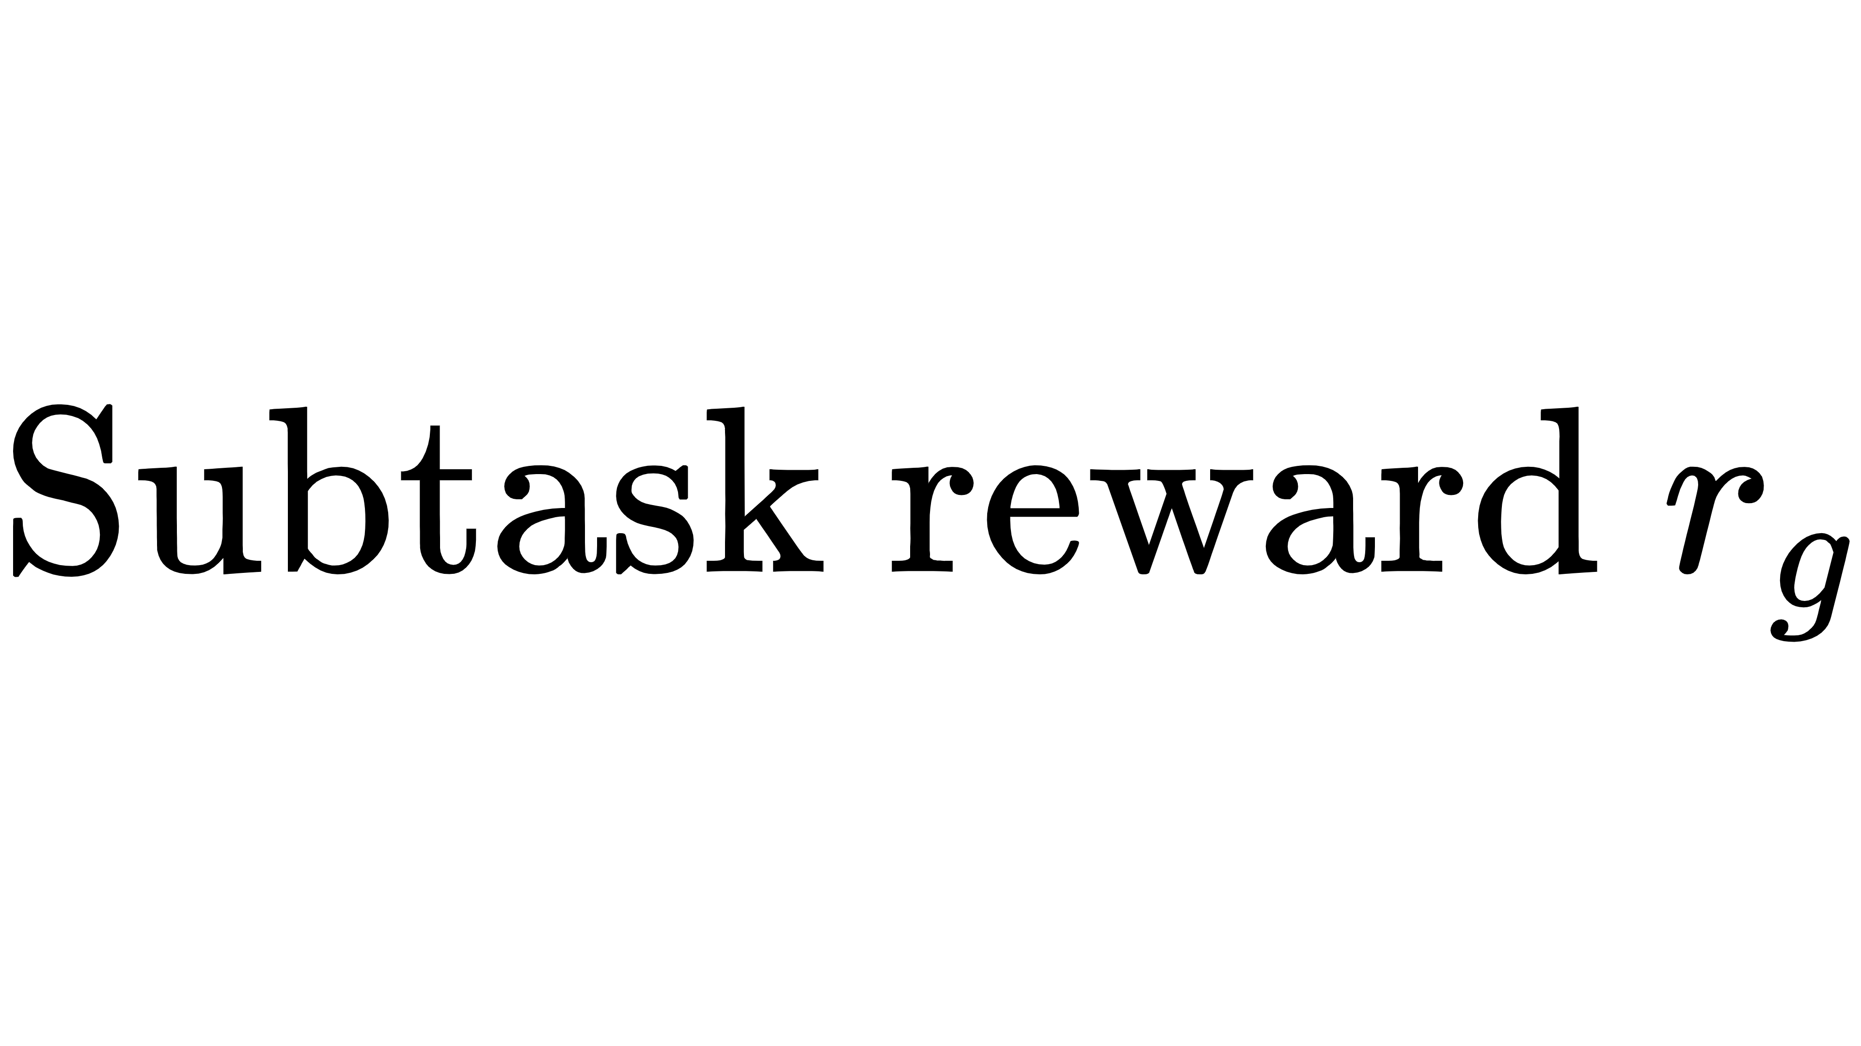
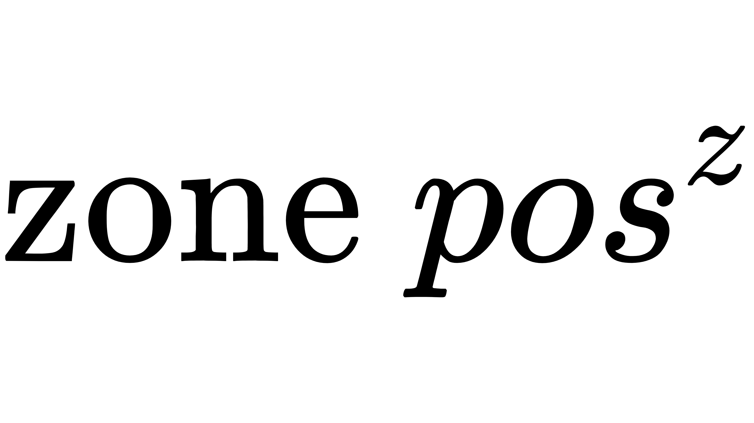
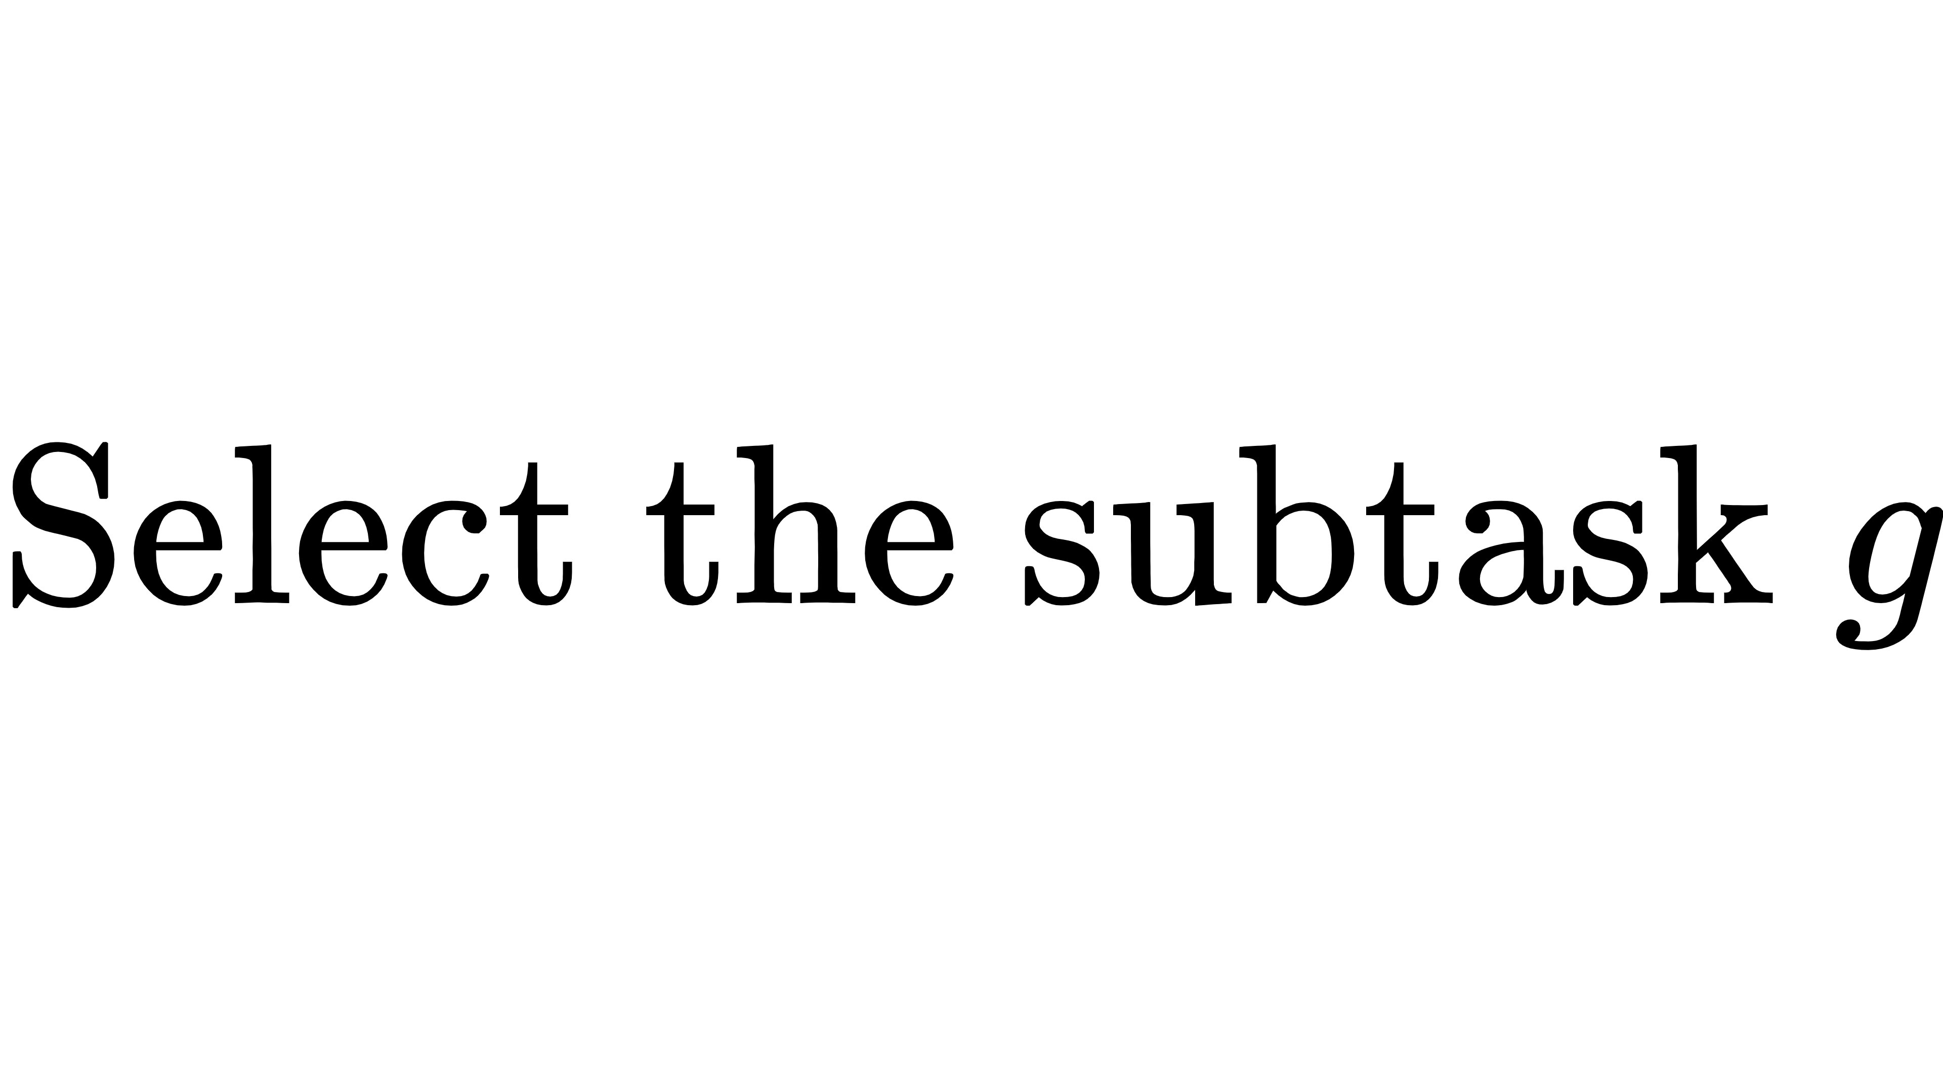
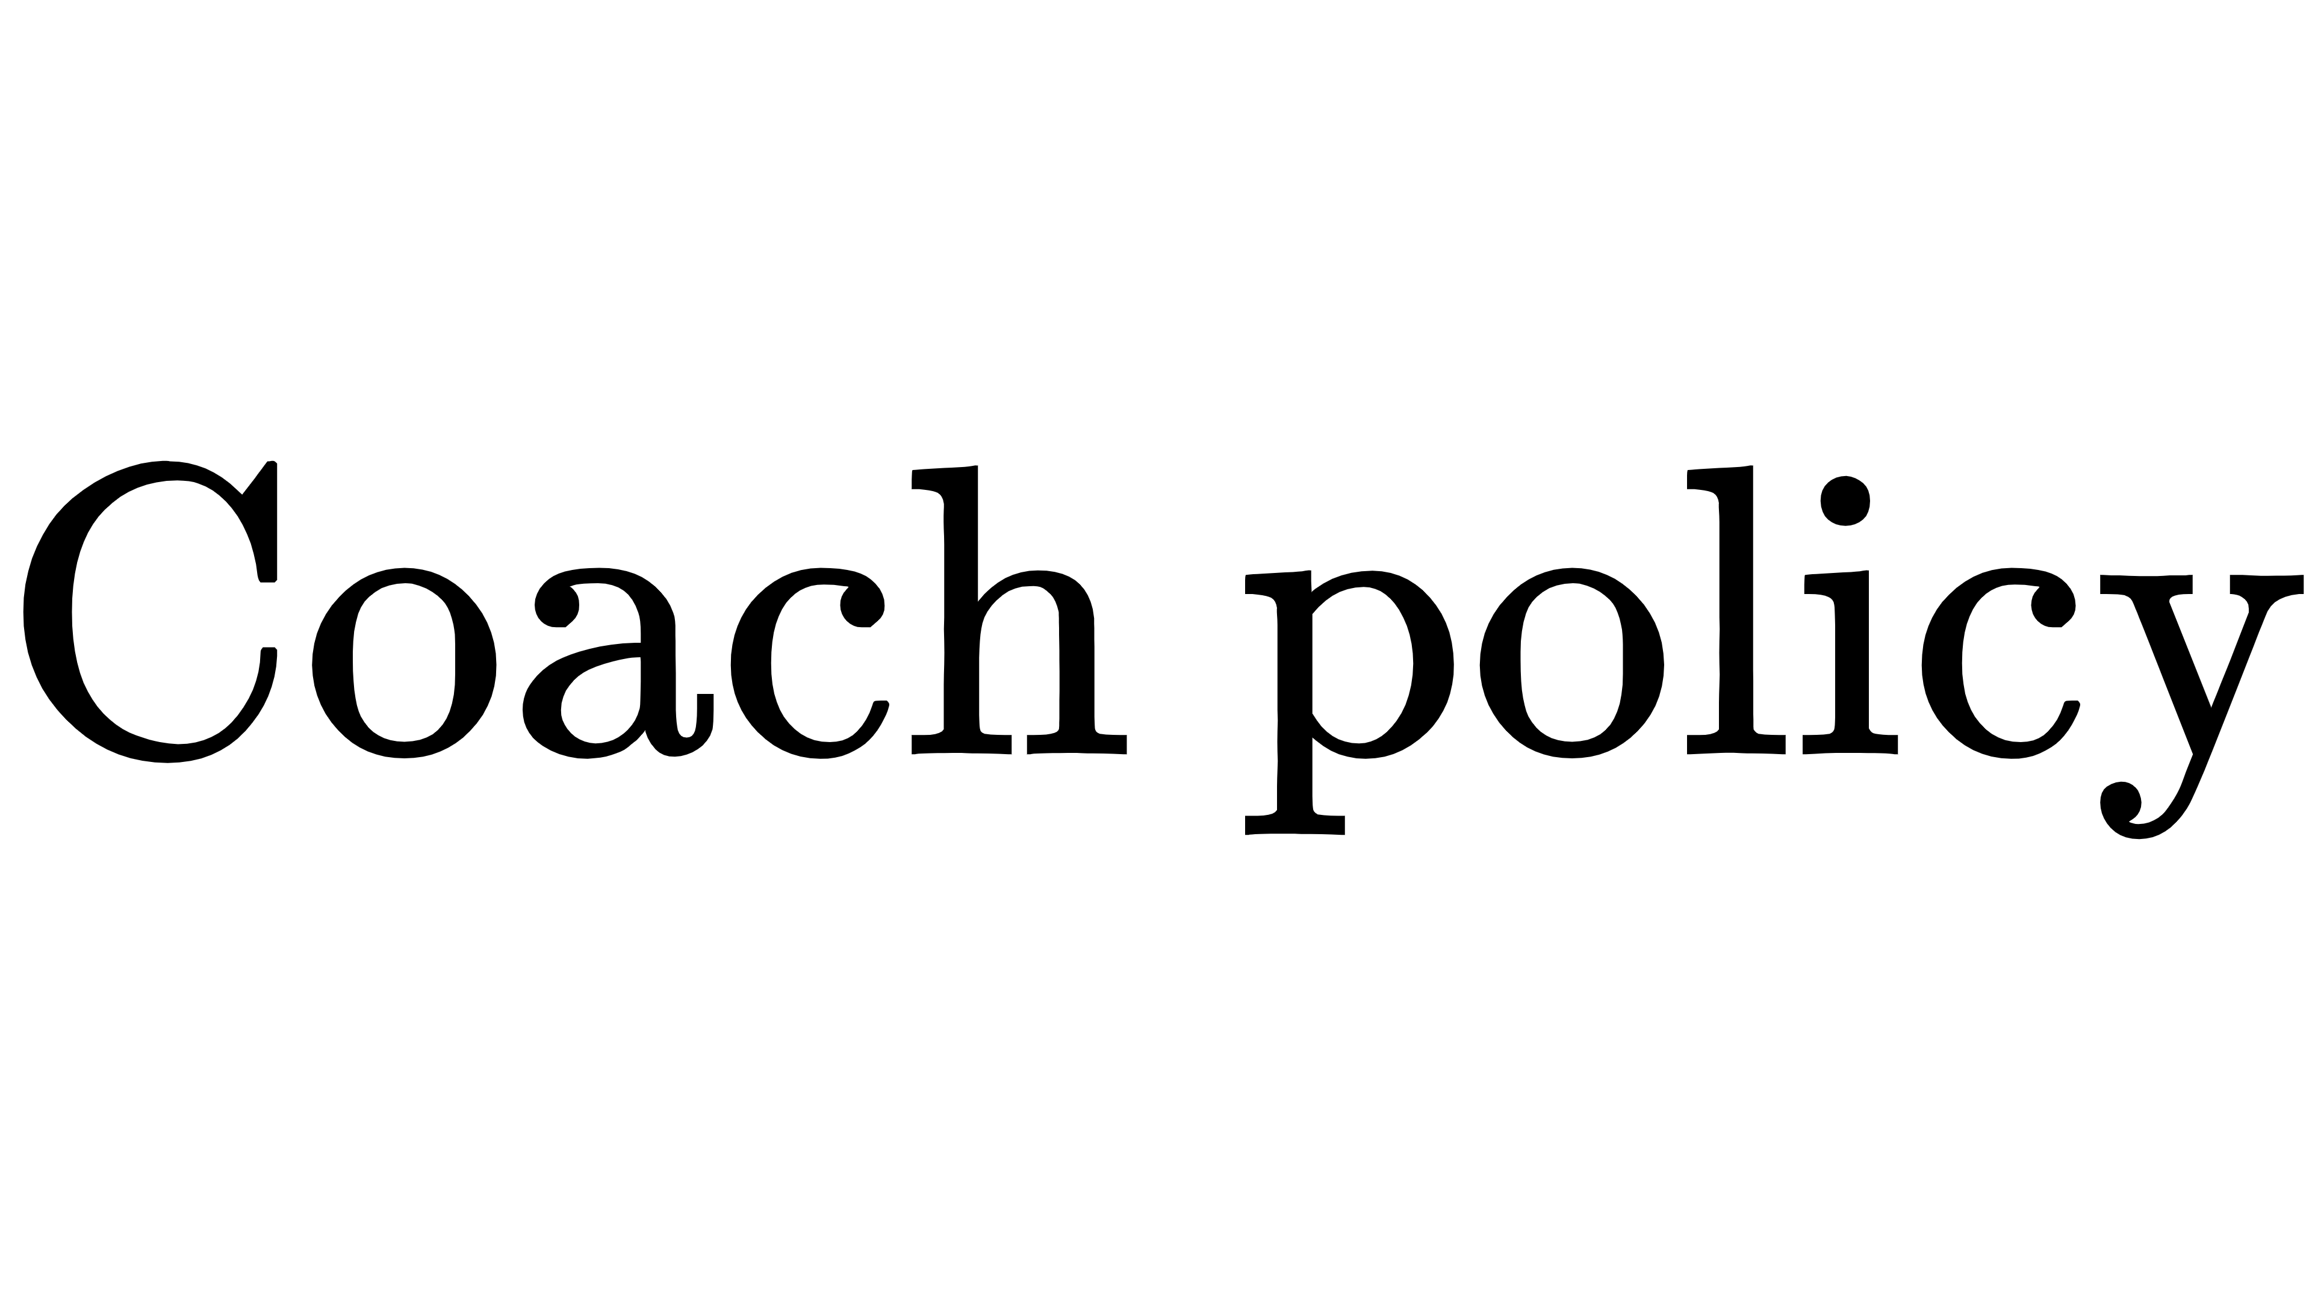
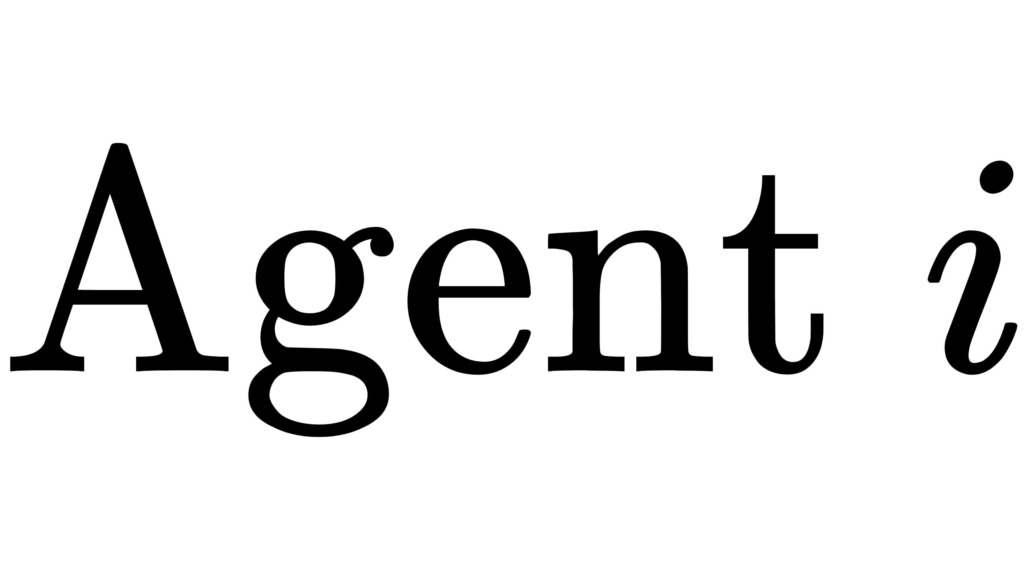
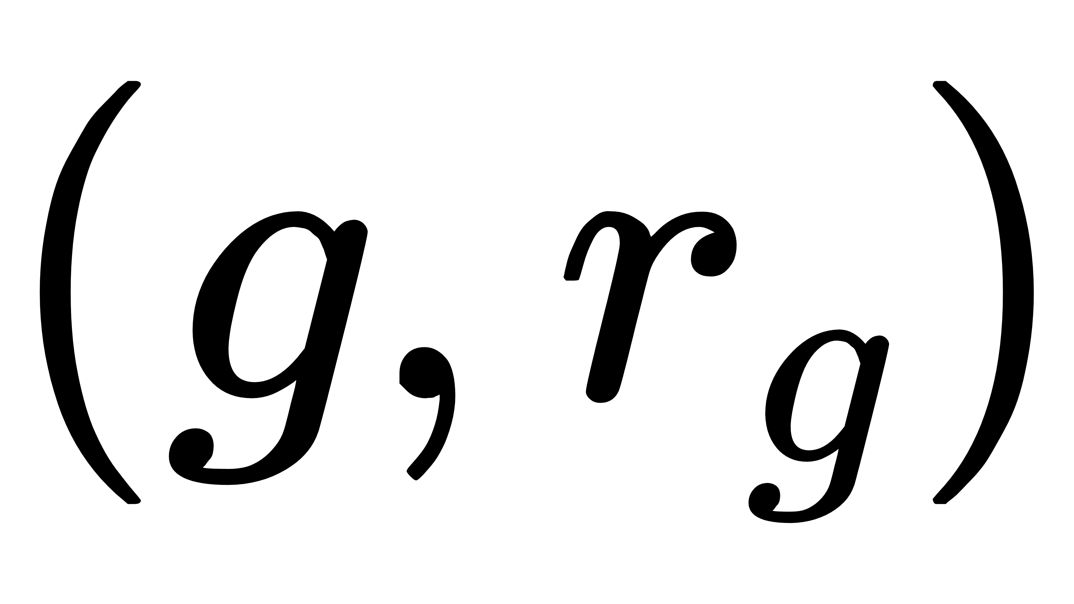

P-HRL: Prediction-based Hierarchical Reinforcement Learning
Hierarchical structure
The coach provides a subtask and subtask reward to the robot controller(MARL).
Coach: adjusting soccer tactics
Robot controller: learning robot control.
The robot controller uses a MARL method(MADDPG).
Added subtasks to actors and critics
Offensive subtask
②
High-level policy
Defensive subtask
②
①
state
③
action
state, reward

Slide 7
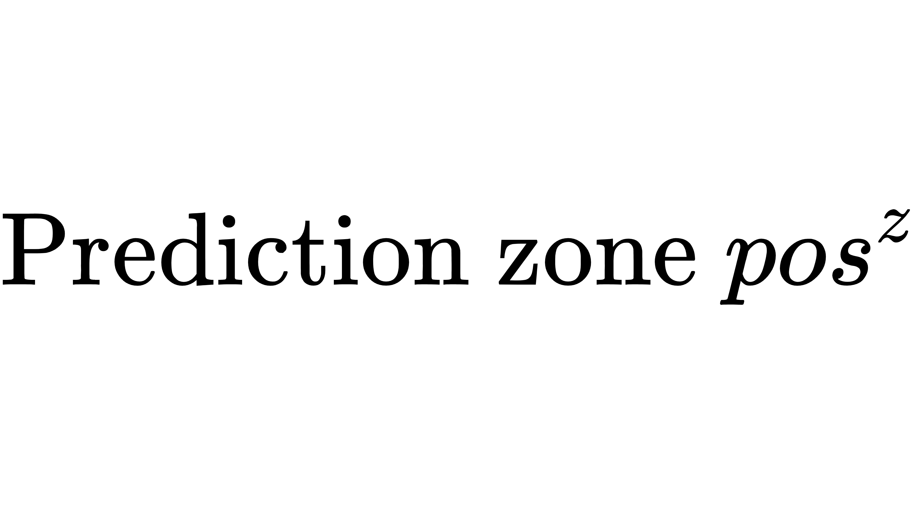



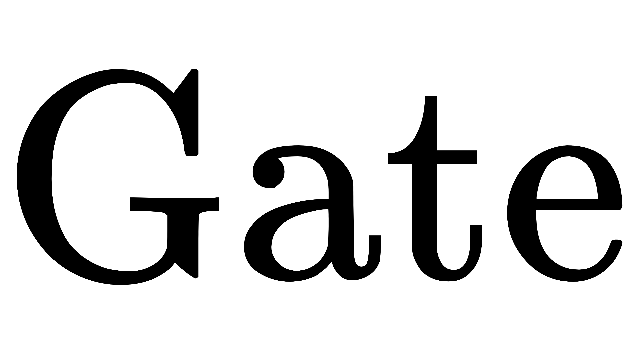
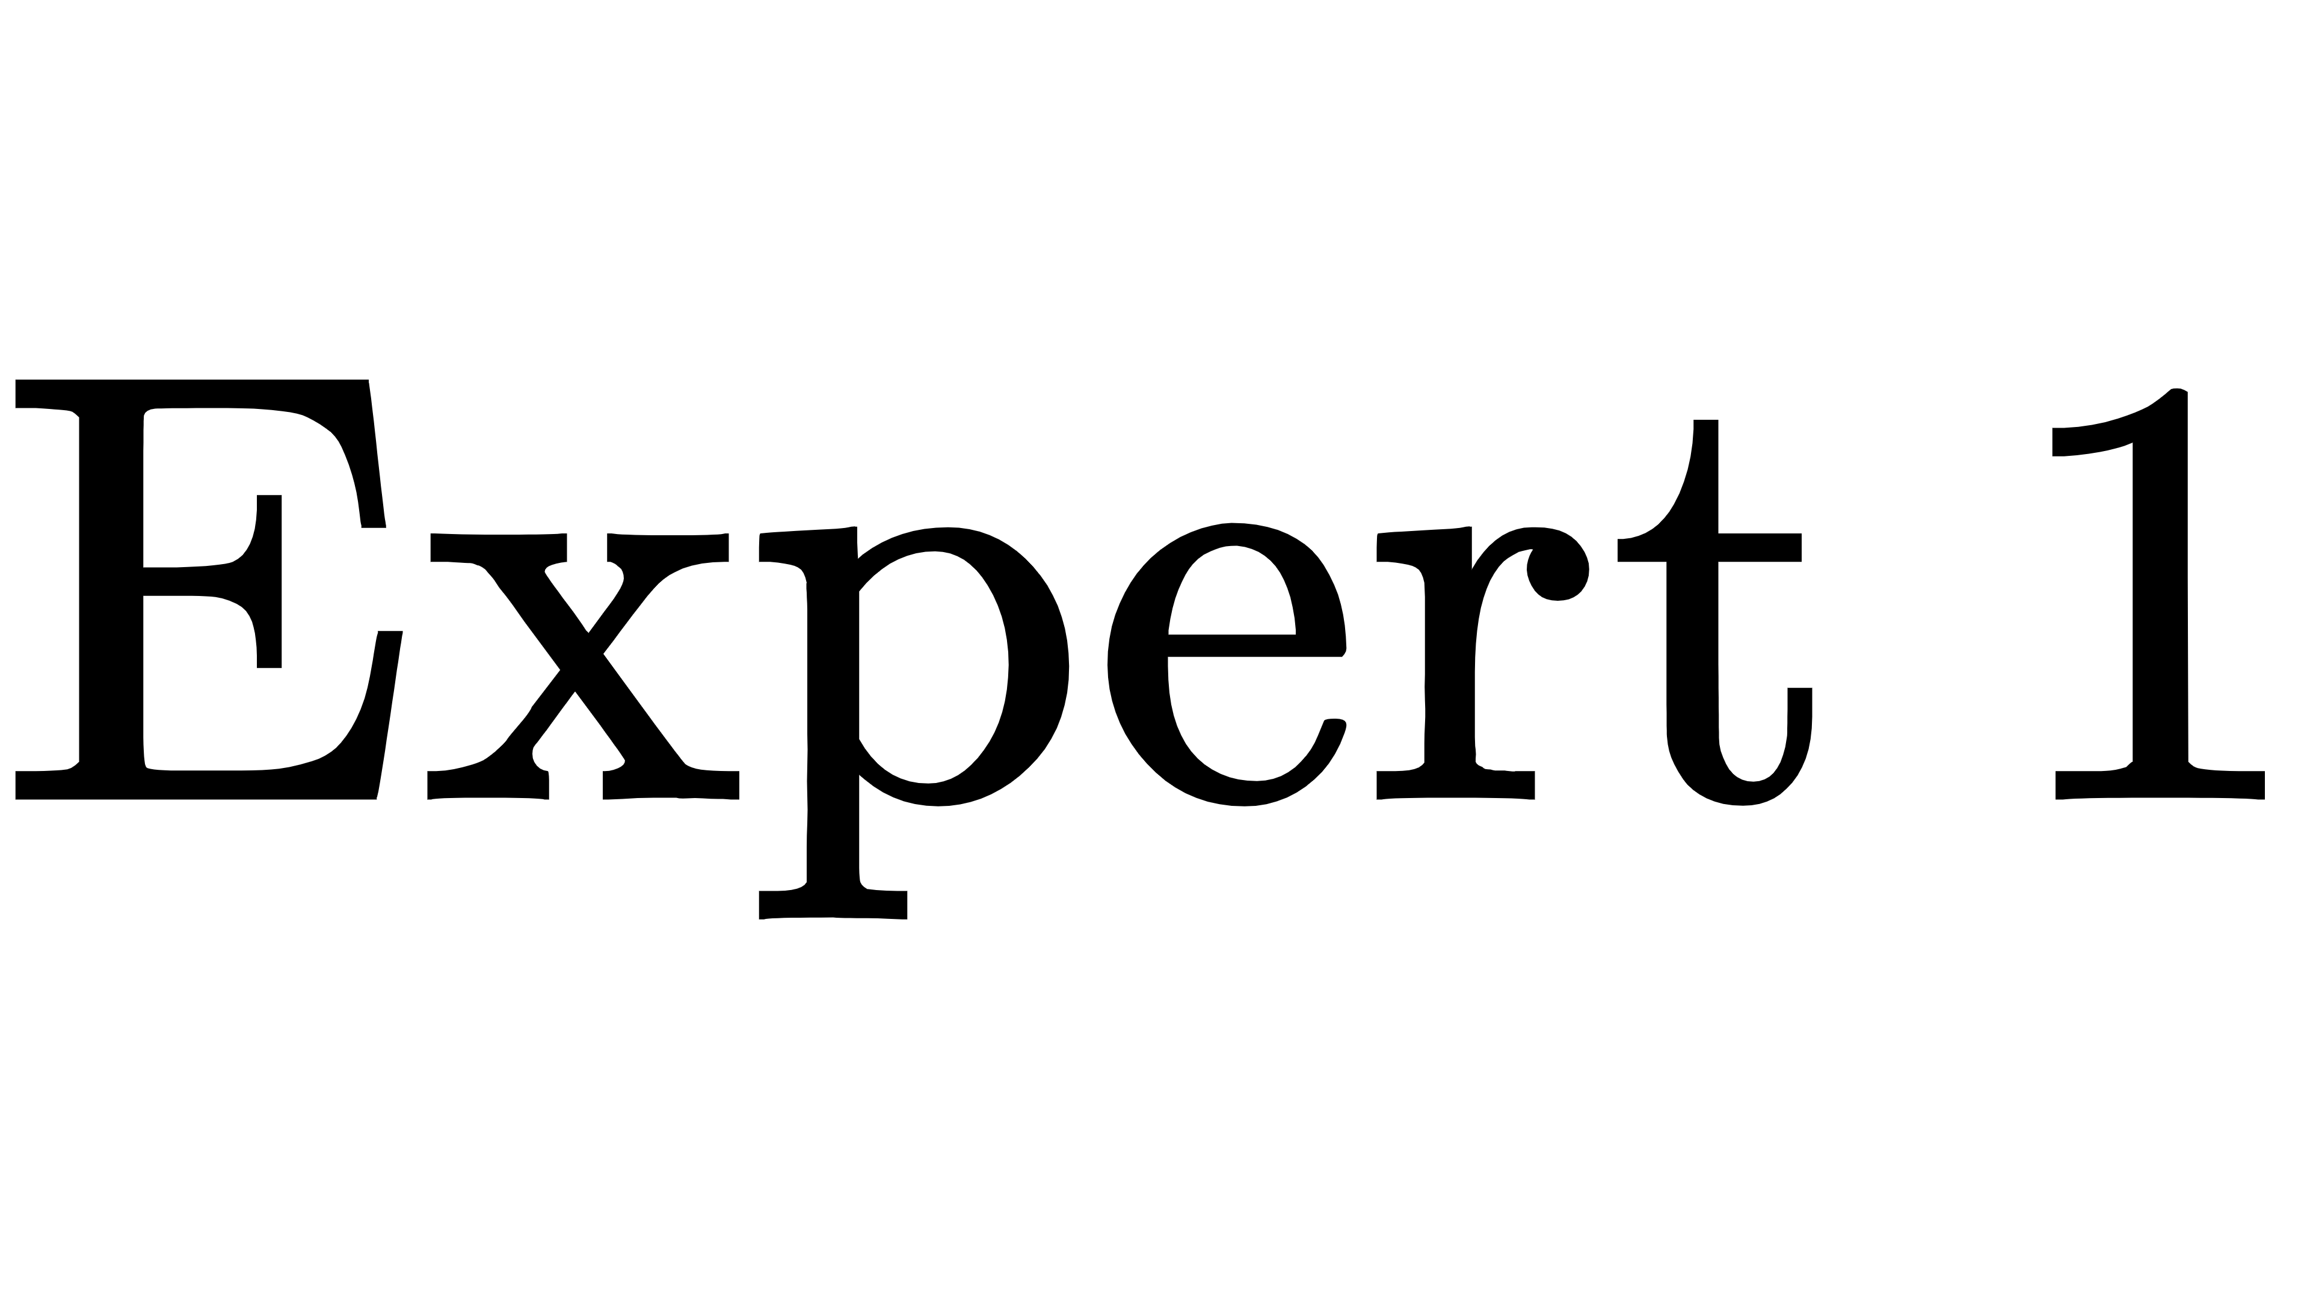
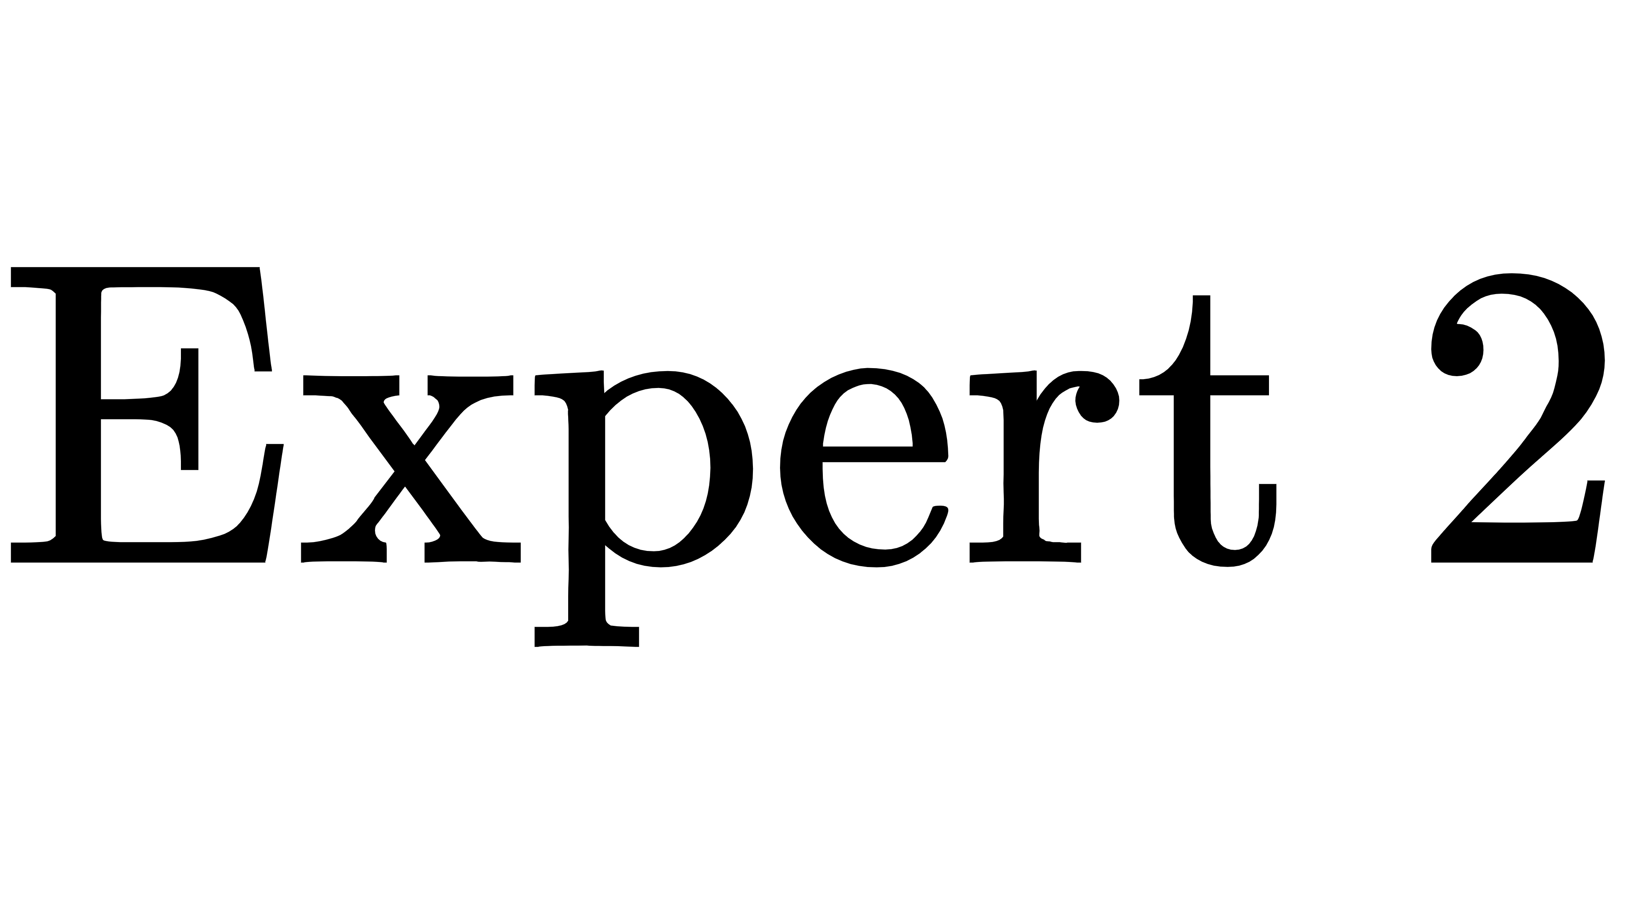
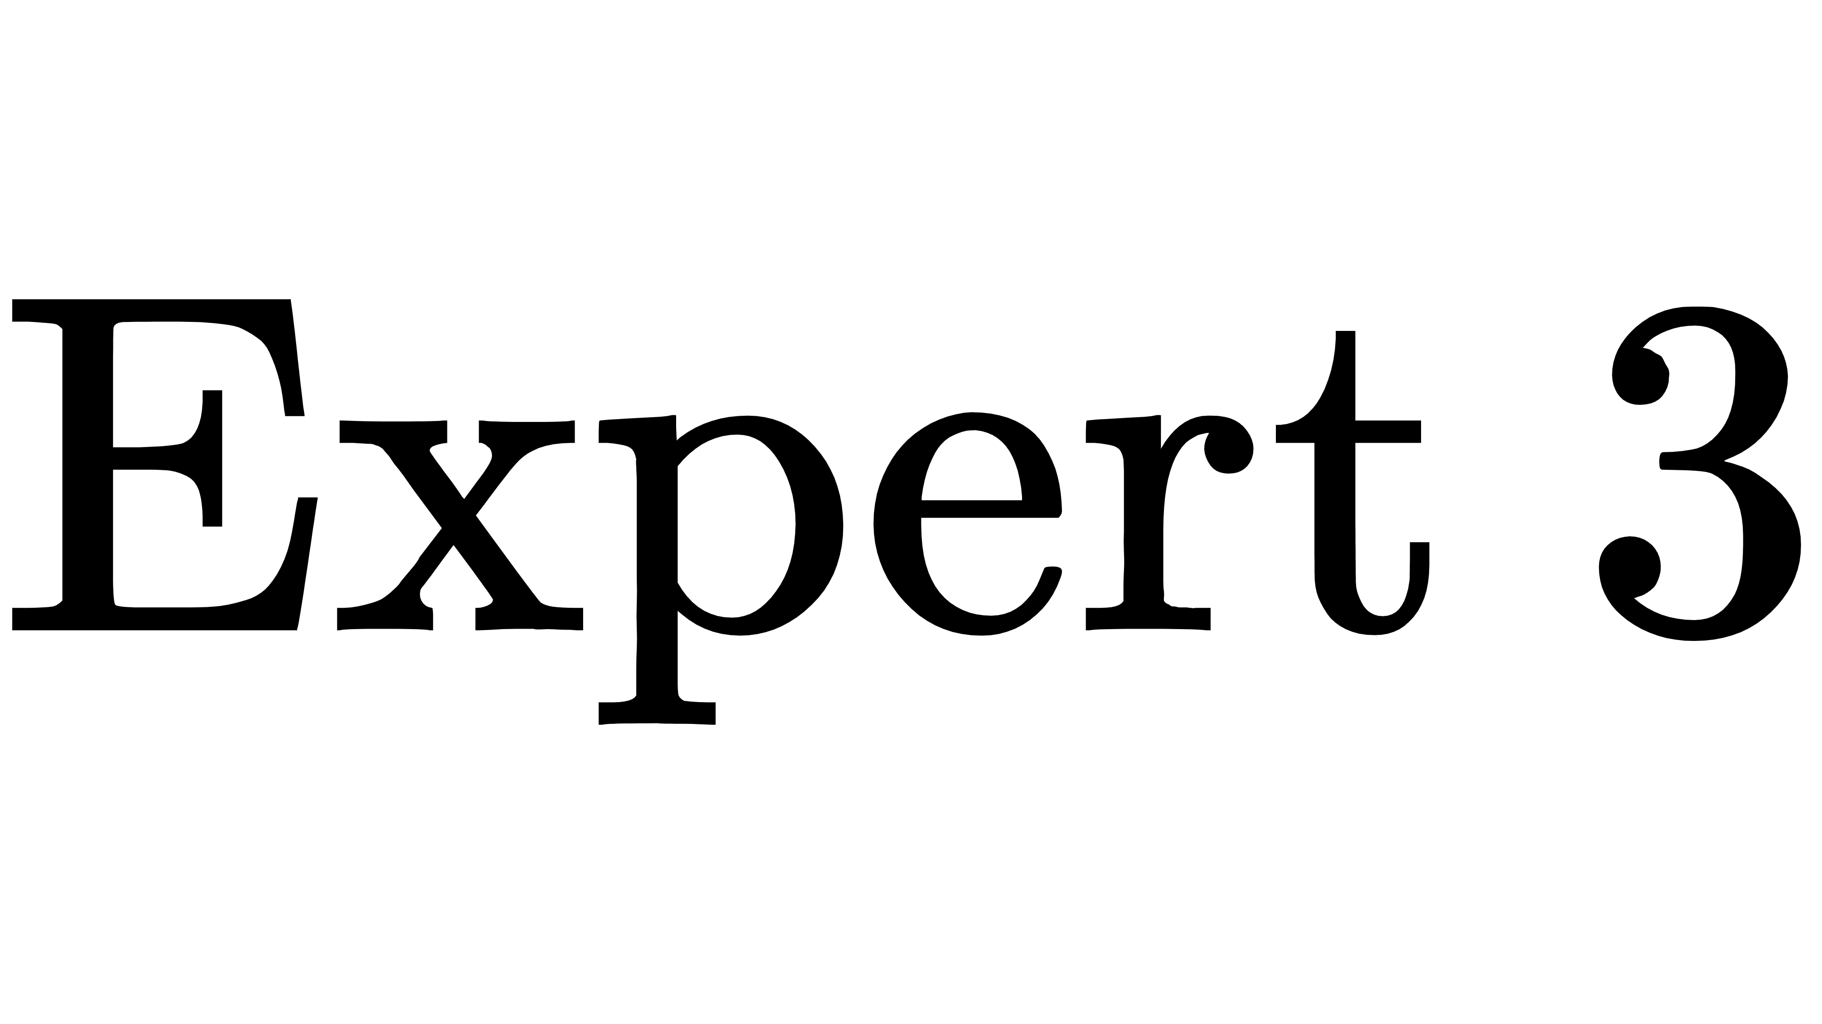

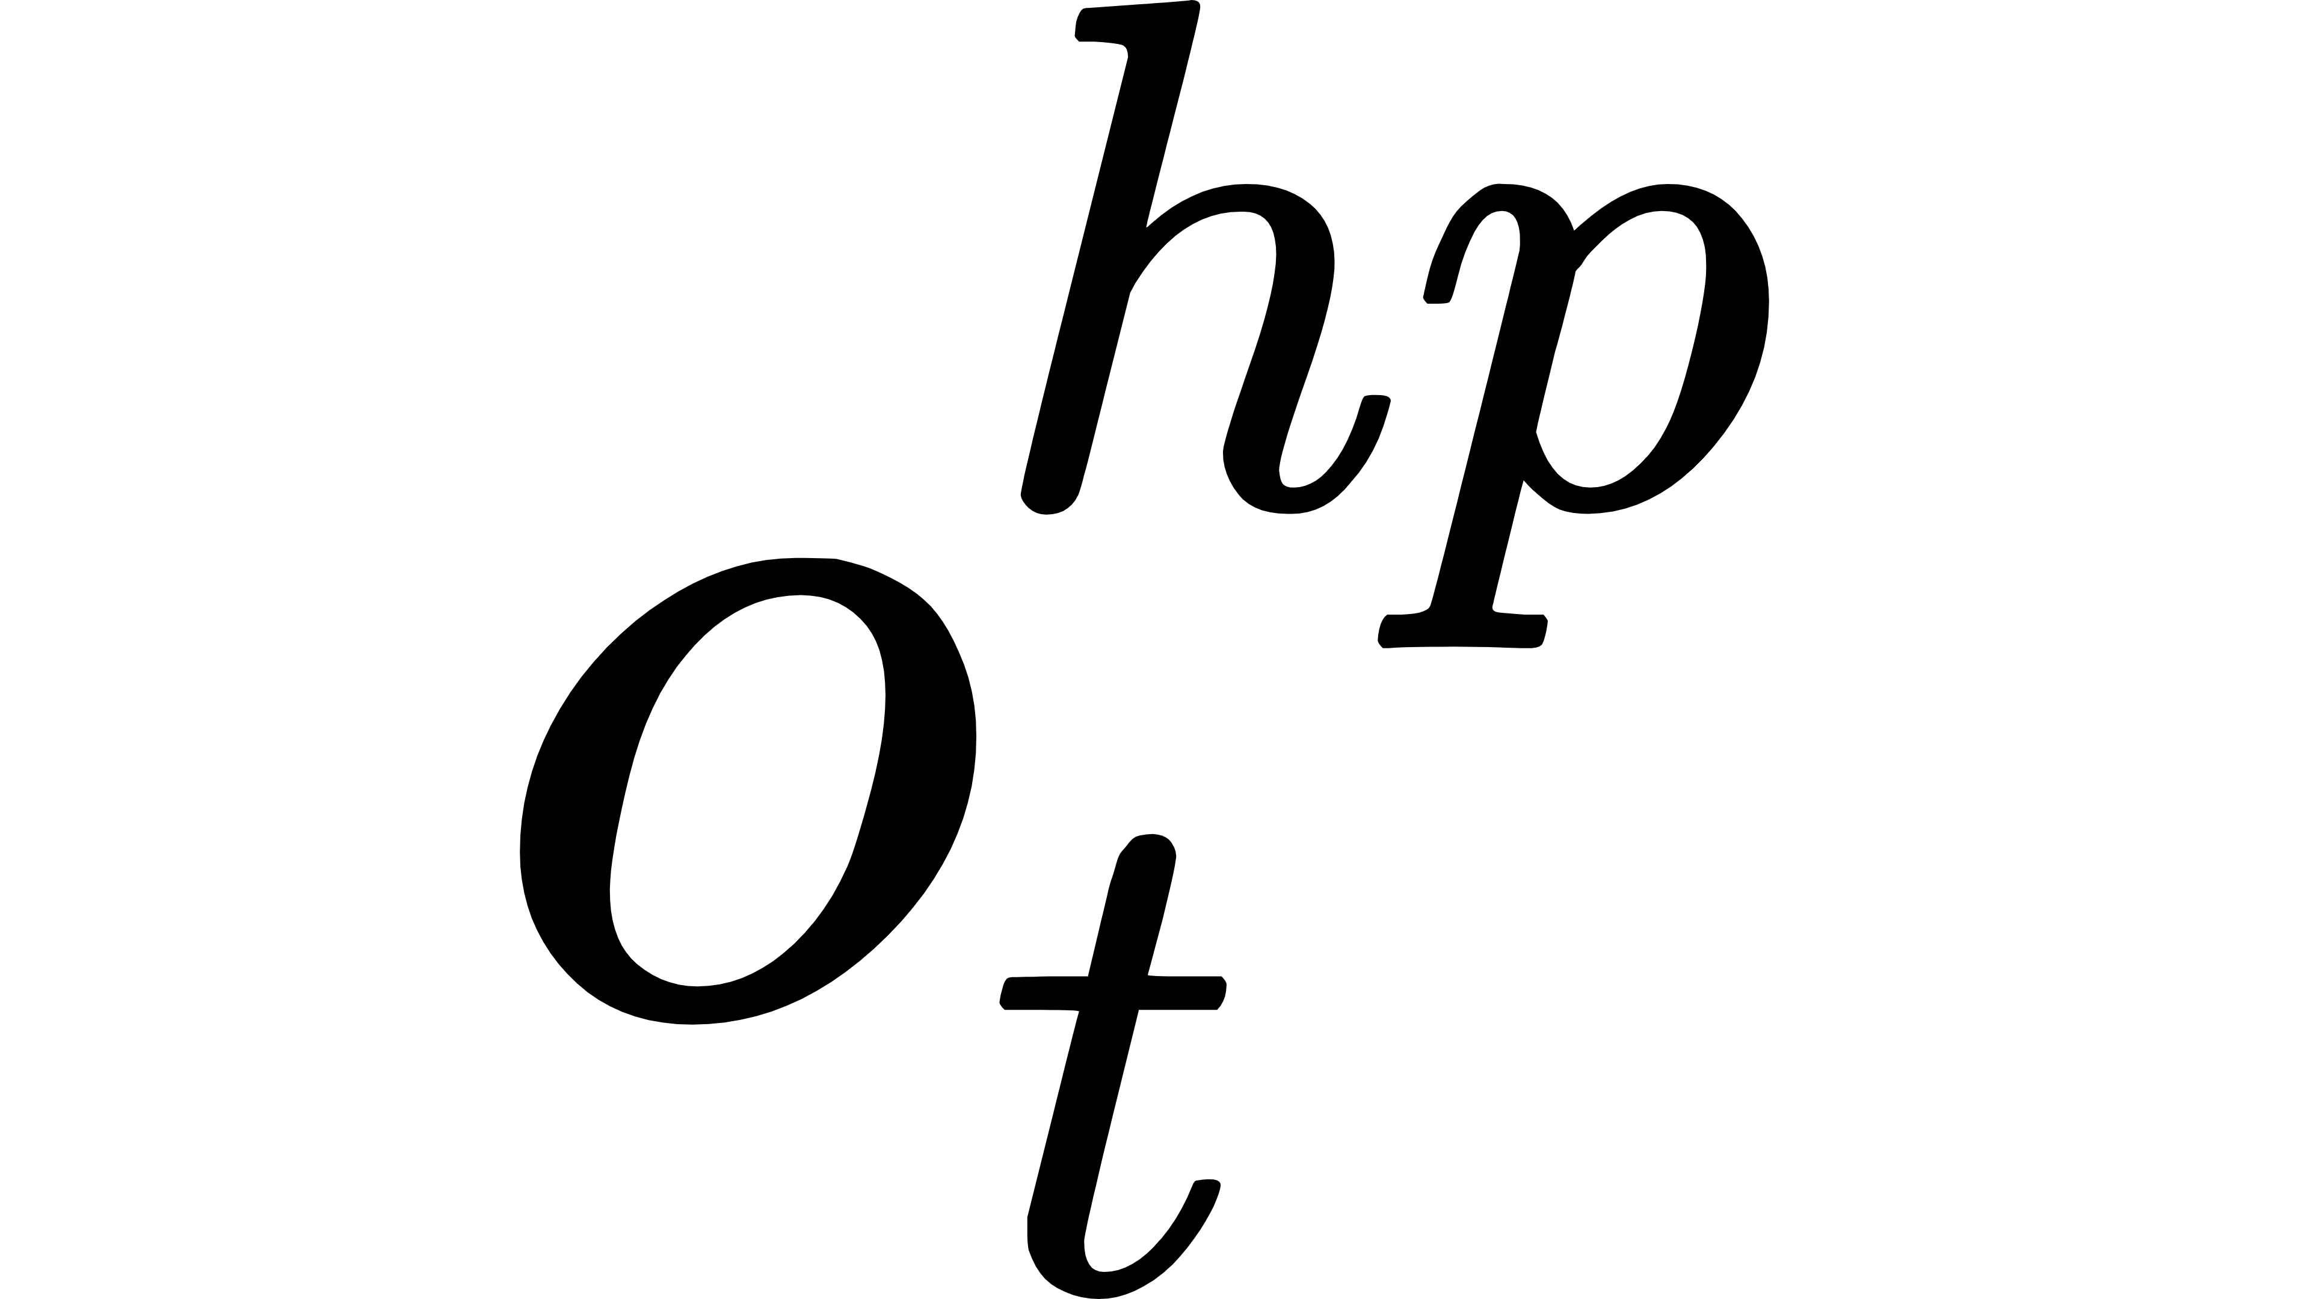
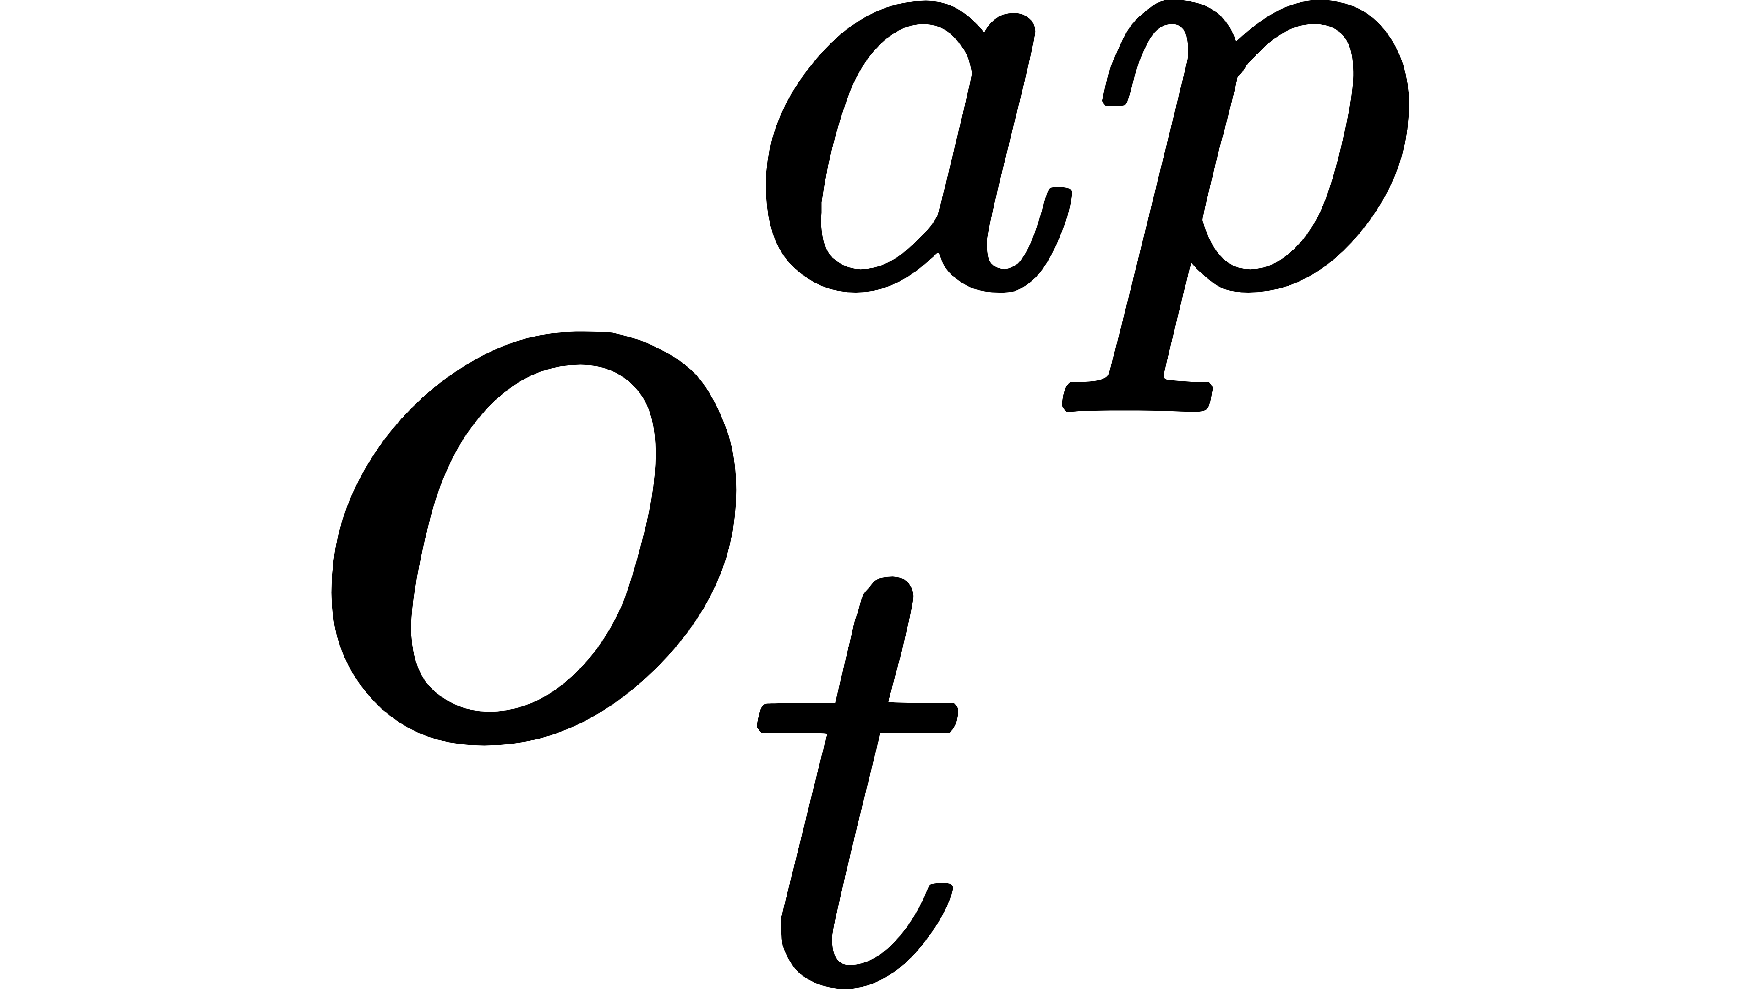
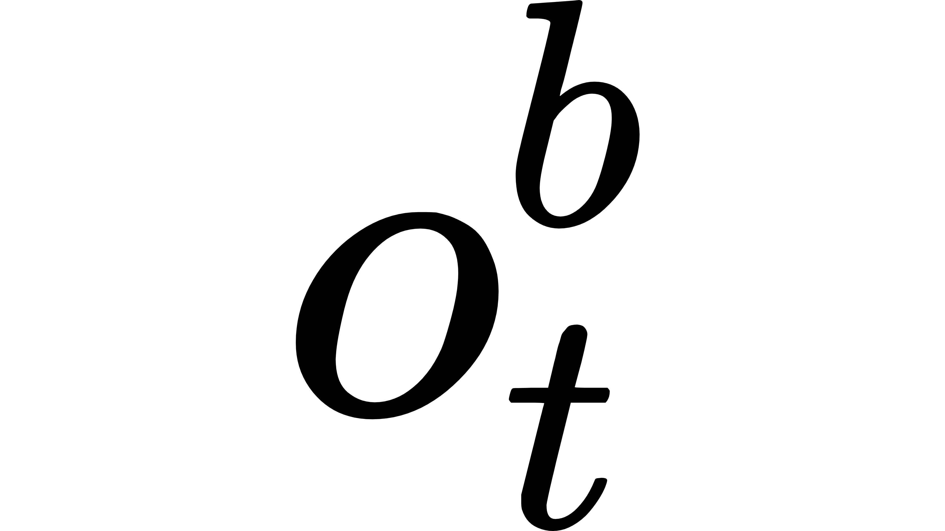
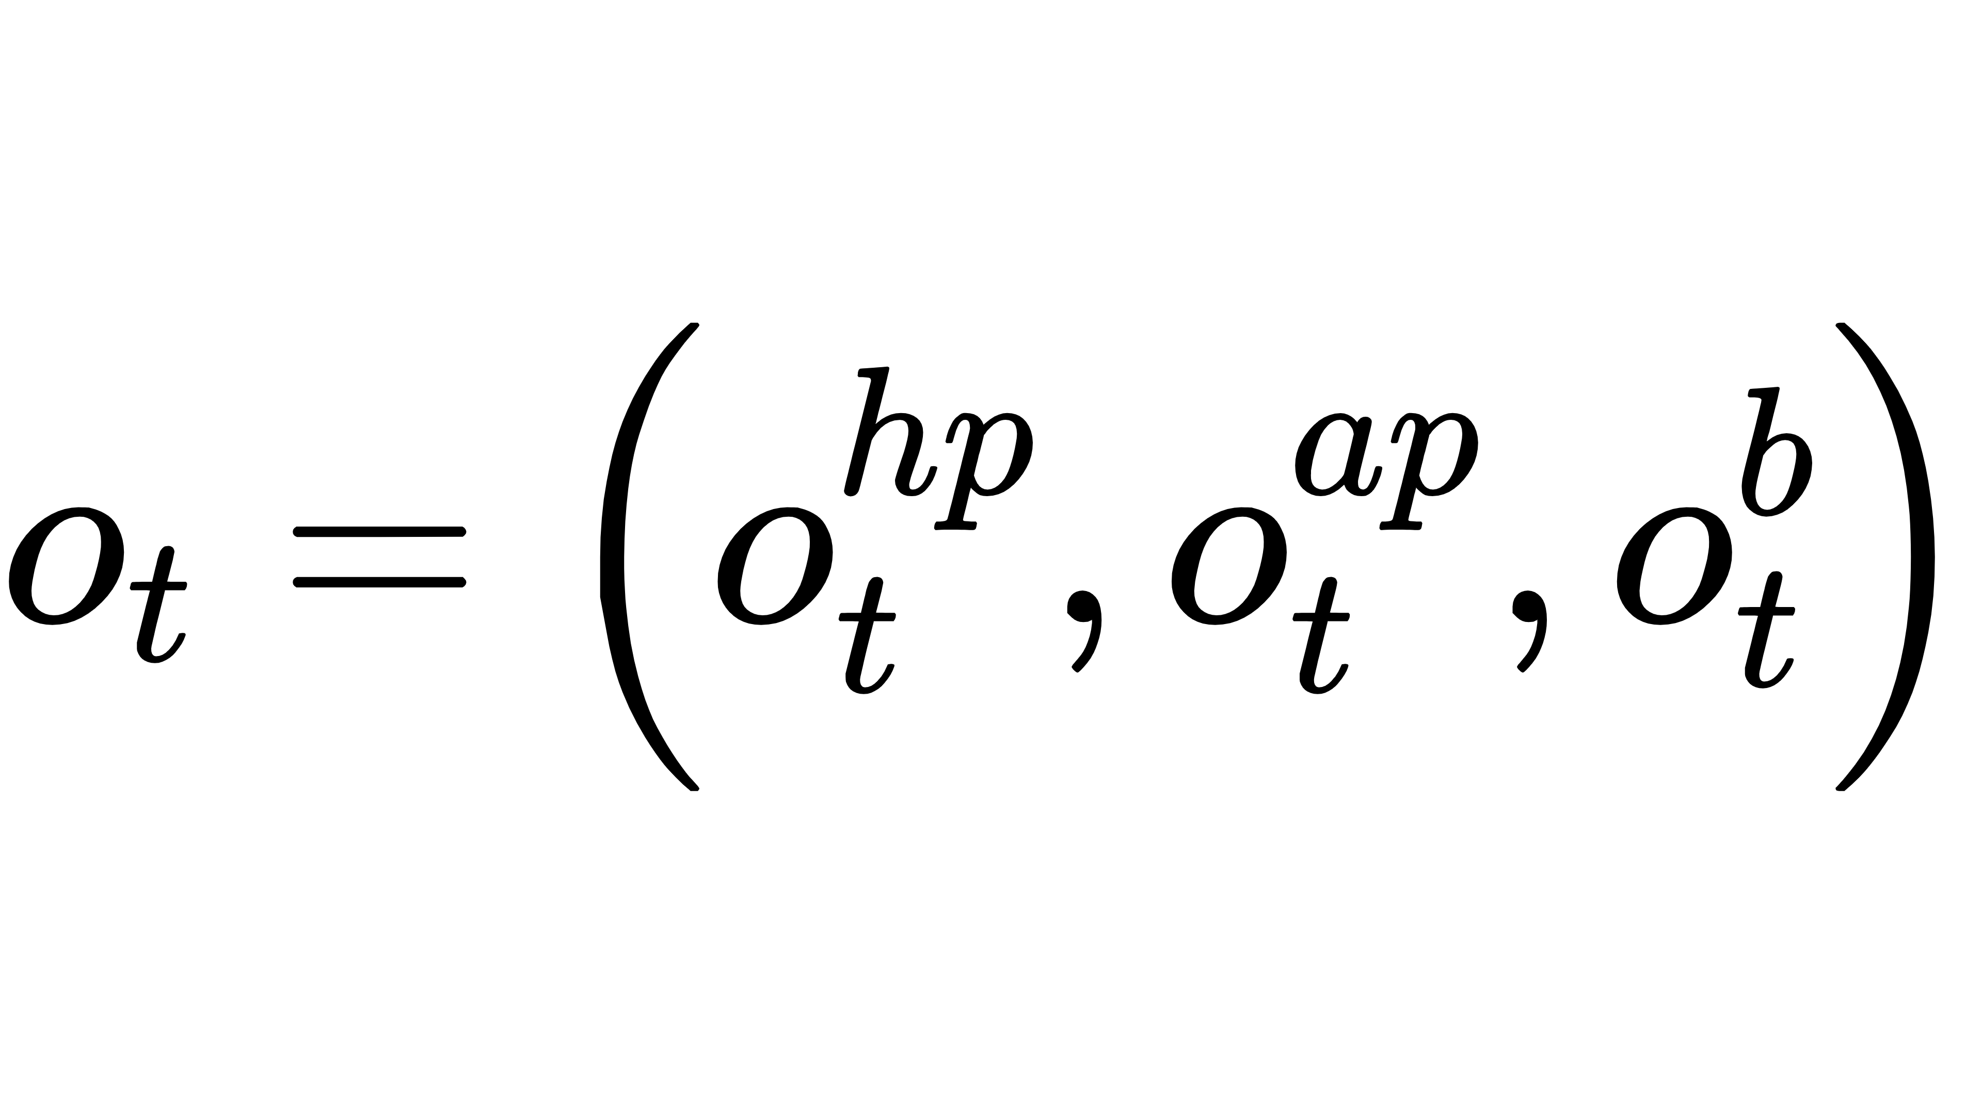

P-HRL: Prediction-based Hierarchical Reinforcement Learning
In the offensive subtask, the robot needs to make judgments about the trajectory of the ball.
The coach helps robot to judge the trajectory of the ball by predicting its position.
Soccer Position Prediction Network(SPPN)
Mixture of experts(MoE) network
Independence of data in state
Easy to convergence
Zoning prediction
Offensive subtask
Defensive subtask
state
state
Soccer Position
Prediction
An example of zoning prediction

Slide 8
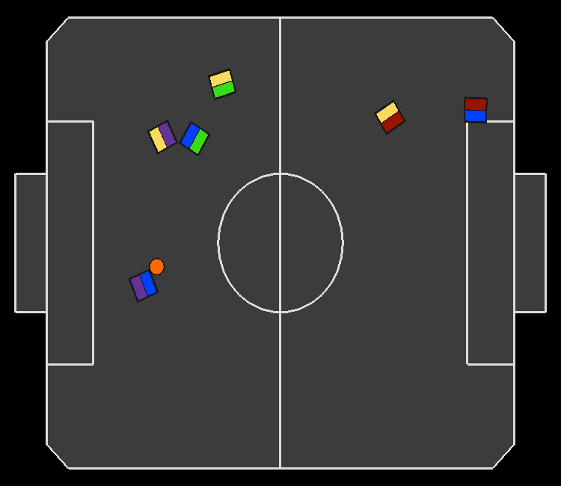
Implementation and Evaluation
Evaluation environment:
rSoccer - IEEE VSSS multi-agent environment to simulate a robot soccer scenario.
Baseline opponent:
MATD3 - a state-of-the-art MARL method that has been used in many multi-agent cooperative tasks similar to robot soccer.
Evaluation settings:
3 vs 3 robot soccer match
No hardware on robots for dribbling or kicking the ball
Follow the rewards shaping in rSoccer
Each match lasting 2000 time steps

Slide 9
Evaluation Questions
How is P-HRL compared to baseline in terms of end-to-end performance?
How does the coach contribute to the overall system?
How well does the P-HRL adapt to the new opponent compared to the baseline?

Slide 10
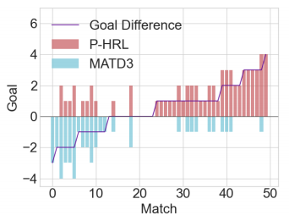
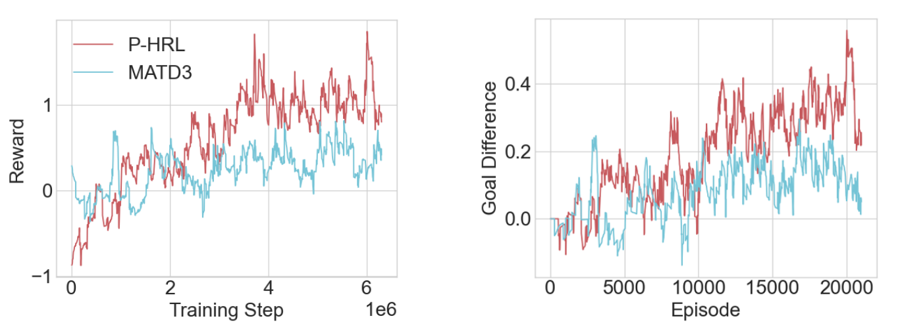
End-to-end Performance
P-HRL has 52% win rate, 22% draw rate and 26% loss rate.
50 matches: P-HRL won 26 matches and tied 11 matches. MATD3 won 13 matches.
Training method：
Stage 1: Train P-HRL and MATD3 respectively, using rSoccer built-in agent as the opponent.
Stage 2: Train P-HRL and MATD3 in a mutual confrontation.
Each stage lasts until the average episode reward does not rise with the episode (about 1×10⁶ steps).
Goal difference：subtracting the number of goals scored by a team from the number of goals conceded in a match.

Slide 11
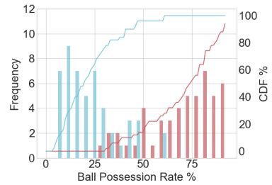
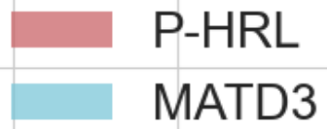
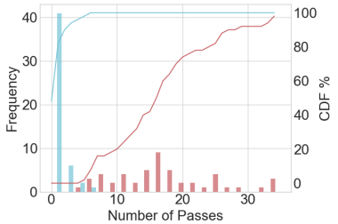
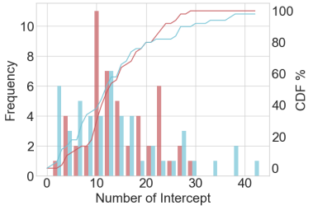
End-to-end Performance
Ball Possession Rate: team possession of the ball as a percentage of total time
Number of Passes: total number of passes on the team
Number of Interception: total number of interceptions on the team
P-HRL outperforms MATD3 in ball possession rate and the number of passes.
 | Ball possession rate (per match) | Number of passes (per match) | Number of interception (per match)
P-HRL | 70.25% | 14.32 | 14.40
MATD3 | 17.14% | 1.92 | 14.44

Slide 12
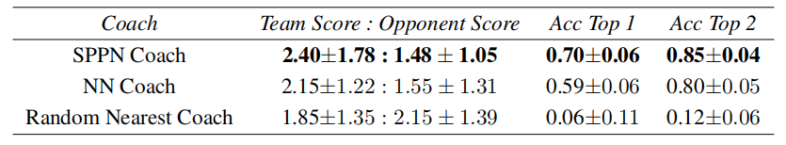
The Effect of the Coach to P-HRL
The coach brings better performance for P-HRL than baseline.
NN Coach: Using a neural network with the same number of parameters as SPPN in the coach (but without the structure of MoE).
Random Nearest Coach: Using a method that selects two random adjacent zones of the current zone as the prediction results in the coach.
Offensive subtask
Defensive subtask
state
state
Match results for different types of coach (vs. MATD3 in 50 matches)

Slide 13
Conclusion
In this talk, we presented P-HRL, a prediction-based hierarchical reinforcement learning.
P-HRL consists of a coach for soccer tactics and a robot controller for robot motion control.
In matches against the state-of-the-art baseline MATD3, P-HRL has 52% win rate, 22% draw rate and 26% loss rate.
We designed several key performance indicators (KPIs) for robotic soccer (e.g., ball possession) to more fully evaluate the performance of the P-HRL.
P-HRL has better cooperation between robots, with 70.25% possession rate compared to 17.14% for baseline.

Slide 14
Future work
P-HRL has been submitted to the International Conference on Automated Planning and Scheduling (ICAPS2023).
Short-term work
Add additional baselines, e.g., MAAC.
Long-term work
Deploying P-HRL to real robots for soccer matches instead of evaluating it in the simulation environment.
Quickly correct deviations between the simulation environment and the real environment.
Using large-scale training models in robot soccer.
Optimize distributed training process.

